Slide 1
Electromagnet & Magnetization
- DJ. Lee -
자바실험실 JavaLab.org

Slide 2
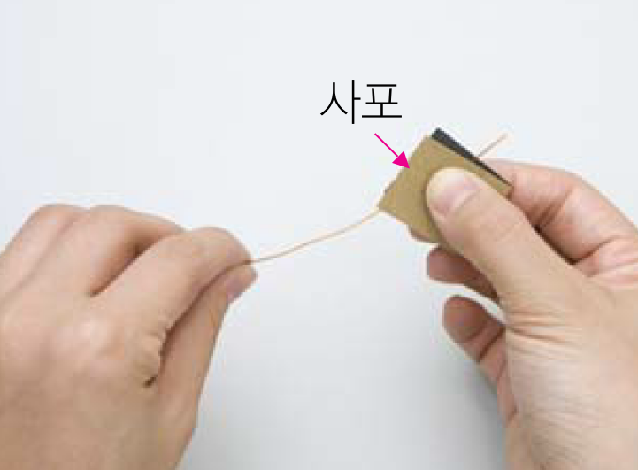
Enamel wire preparation
Peel off with sandpaper
About 1m

Slide 3
Make a paper clip electromagnet
What is the difference between a paper clip electromagnet and an inductor?

Slide 4
Figuring out the polarity
Using the compass.

Slide 5
What if when change the pole?
Using the compass.

Slide 6
Guessing the polarity, N or S?
S
N
( A )
( B )
S
N
( C )
( D )

Slide 7
Making a permanent magnet
- Caution -
Rub only one direction!
Do not change rubbing direction during magnetization.

Slide 8
Guessing the polarity, N or S?
S
N
( A )
( B )
S
N
( C )
( D )

Slide 9
Marking the North Pole
S
N
( A )
( B )
S
N
( C )
( D )

Slide 10
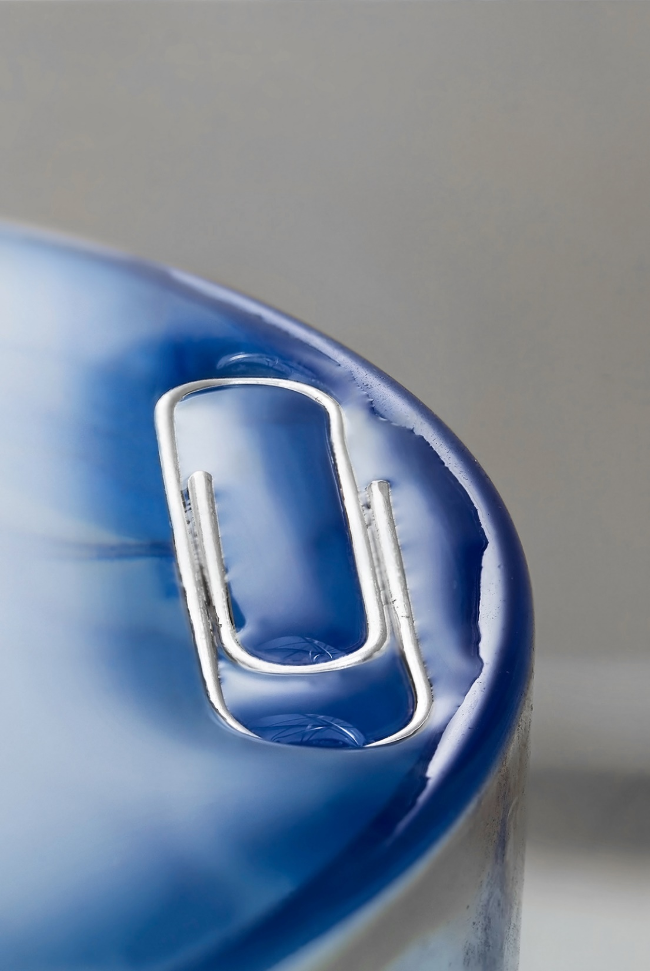
Find the north direction & south direction
Can you float the clip on water surface?

